Slide 1
A WEB BASED SENTIMENT-CENTRIC NEWS PORTAL USING SVM AND CNN WITH TIME SERIES ANALYSIS THROUGH LDA
1023 | Prayusha Acharya
Title defense of Project-III – CSC412– Class of 2024

Slide 2
Outline
Introduction
Problem Statement
Objective
Scope
Literature Review/Background Study
Methodology
Tools and Technology
Expected Outcome
Reference

Slide 3
Introduction
The core of the sentiment analysis will be powered by algorithms combining Support Vector Machines (SVM) with Convolutional Neural Networks (CNN).
Time-series analysis capability, using Latent Dirichlet Allocation (LDA) to visualize sentiment trends over time.
Valuable for anyone interested in gaining insights into Nepali public opinion and news trends, ultimately fostering more informed decision-making.

Slide 4
Problem Statement
Language barriers for non-Nepali speakers
Frequent news exposure to bad news can be toxic
Sorting news articles into accurate categories is a challenging task that often relies on manual effort.
Understanding how sentiment evolves over time in response to specific events or topics.

Slide 5
Objective
To create an advanced sentiment analysis model using CNN with SVM that accurately interprets the emotional tone of news articles.
To develop a time-series analysis feature using LDA to track and visualize sentiment trends over time.

Slide 6
Scope
Develop a web crawler to collect news articles from various Nepali news portals.
Implement a translation module to convert Nepali articles into English, ensuring accessibility for a global audience.
Integrate sentiment analysis algorithms combining SVM and CNN to accurately assess the emotional tone of news articles.
Develop an automated system to classify news articles into genres such as sports, politics, international affairs, and finance.

Slide 7
Scope
Implement LDA for tracking and visualizing sentiment trends over time.
Design a user-friendly interface to display aggregated news articles, sentiment analysis results, genre classifications, and sentiment trends.

Slide 8
Literature Review/Background Study
Emotional Impact of News on Social Judgments (Baum, 2021) explores how emotional news content affects social judgments [3].
Social Media News Headlines and Well-Being (Mousoulidou et al., 2024) provides insights on the influence of social media news headlines on well-being [4].
Ensemble Machine Learning for Twitter Sentiment Analysis (Radiuk et al., 2022) discovered that the CNN model with the SVM classifier demonstrated the best performance than any other techniques [5].
N-Gram, TF-IDF, and Ensemble Methods in Sentiment Classification (Rahman et al., 2020) explored different n-gram models [6].

Slide 9
Literature Review/Background Study
Multilingual Sentiment Analysis (Das et al., 2023) emphasized the critical role of text preprocessing techniques, particularly highlighting the Porter Stemming Algorithm [7].
LDA Topic-Based Sentiment Analysis in Tourism (Ali et al., 2022) demonstrates the application of Latent Dirichlet Allocation (LDA) for topic-based sentiment analysis [8].

Slide 10
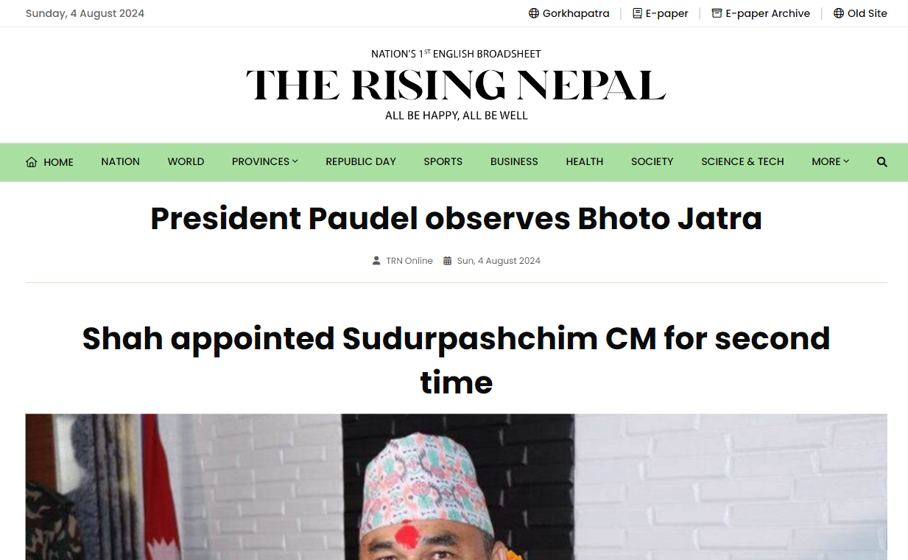
Methodology
Study of Existing System
The Rising Nepal
Limitations:
  Language Limitation
  Technical Issues
  Lack of Sentiment Analysis
Fig: Home Page of The Rising Nepal [1]

Slide 11
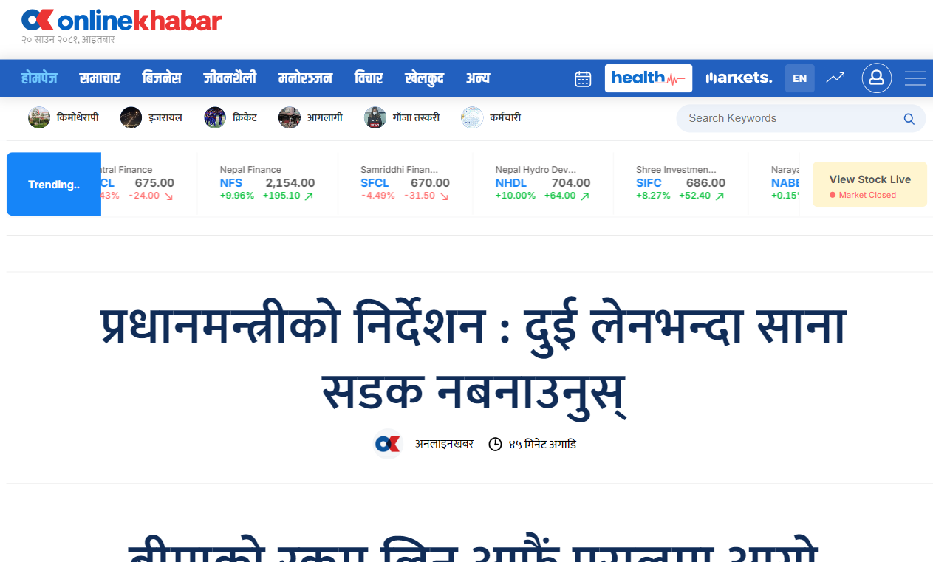
Methodology
Study of Existing System
Online Khabar
Limitations:
  Language Barrier
  Lack of Sentiment Analysis
Fig: Home Page of Online Khabar [2]

Slide 12
Methodology
Functional Requirements
The system shall automatically translate the extracted Nepali content into English.
The system shall categorize news articles into respective genres such as sports, politics, international affairs, and finance.
The system shall classify the sentiment of news articles as positive, negative, or neutral.

Slide 13
Methodology
Functional Requirements
The system shall visualize sentiment trends over time for specific topics and entities.
The user shall be able to filter news articles by sentiment, genre, and date.
The user shall be able to login to the website to view their saved news articles.

Slide 14
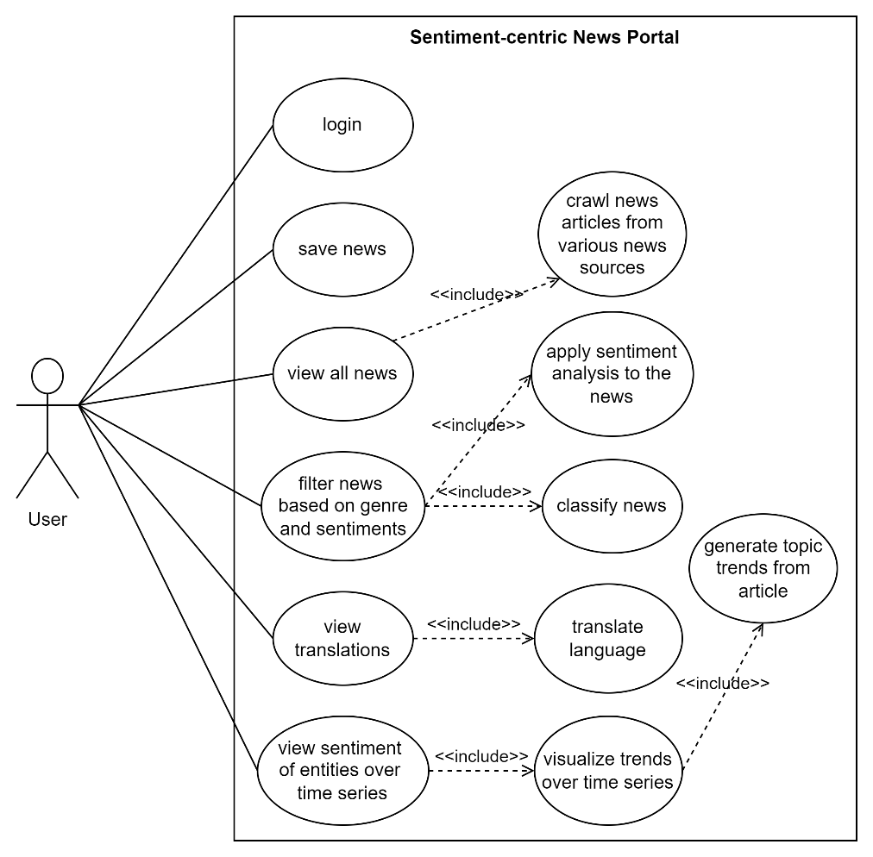
Use Case Diagram
Fig: Use Case of Sentiment-centric News Portal

Slide 15
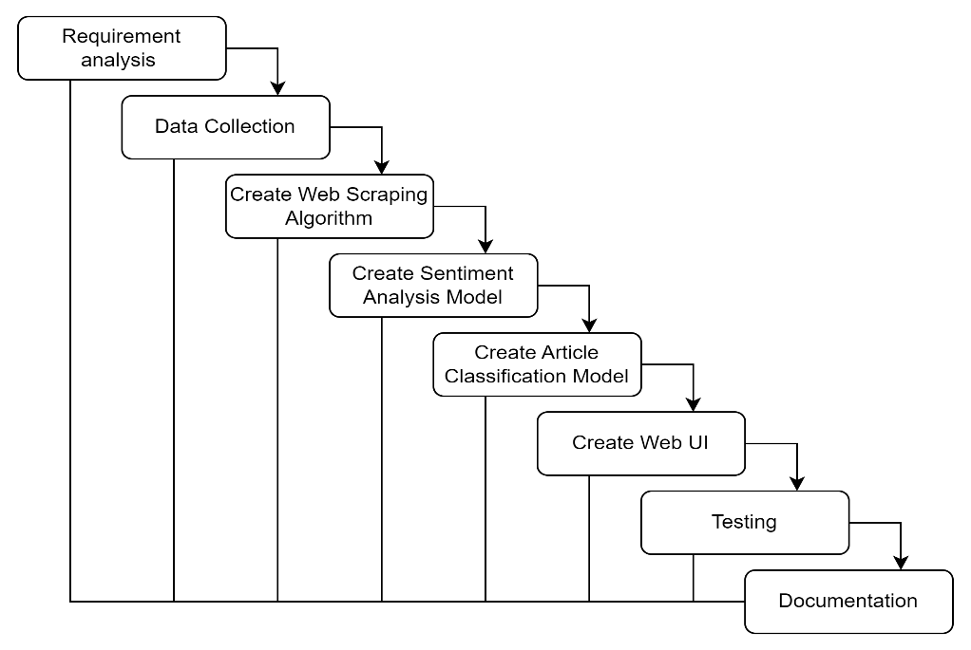
System Design
Fig: Waterfall Model for System Development

Slide 16
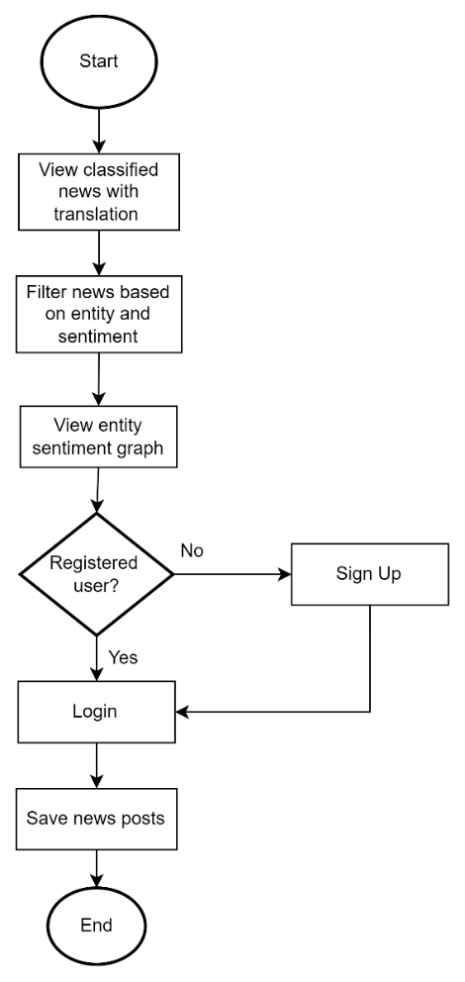
High Level System Design
Fig: Flowchart for Users of the Sentiment-centric News Portal

Slide 17
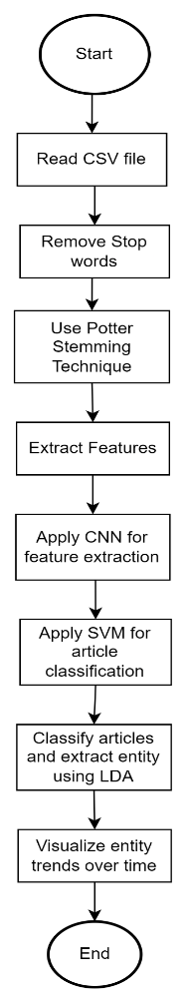
High Level System Design
Fig: Flowchart for the Implementation of Algorithms

Slide 18
Tools and Technologies
Python: Primary language for implementing machine learning algorithms and backend development
JavaScript: For frontend development and interactive visualizations
Beautiful Soup: For parsing HTML and extracting news content
Flask: Lightweight web framework for building the backend API
Jupyter Notebook: For prototyping and testing machine learning models
NLTK (Natural Language Toolkit): For text preprocessing and Porter Stemming

Slide 19
Algorithms
SVM will help in classifying news articles based on their sentiment.
CNN will be used to extract meaningful features from the text.
Ensemble model (the combination of SVM and CNN) leverages the strengths of both algorithms.
LDA will be used to classify and track how sentiment evolves for specific topics.
The Porter Stemming technique will be used in the preprocessing stage to standardize words before sentiment analysis

Slide 20
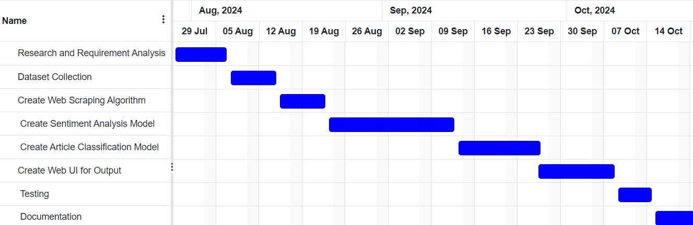
Gantt Chart
Fig: Gantt Chart for the Sentiment-centric News Portal

Slide 21
Expected Outcome
An intuitive user interface through which the portal will provide the public with valuable insights into the sentiment trends in Nepali news.
Reduce the psychological burden associated with consuming overwhelming and often negatively biased news content.
Empower users by tracking sentiment trends over time.
Bridge the language gap, allowing older generations who may be more comfortable with Nepali and younger or international audiences who primarily use English to access the same content.

Slide 22
References
[1] | "The Rising Nepal | Nepal's First English Broadsheet Daily.," [Online]. Available: https://risingnepaldaily.com/. [Accessed 4 August 2024].
[2] | "Online Khabar," [Online]. Available: https://www.onlinekhabar.com/. [Accessed 4 August 2024].
[3] | R. A. R. Julia Baum, "Emotional news affects social judgments independent of perceived media credibility," Social Cognitive and Affective Neuroscience, vol. 16, no. 3, 2021.
[4] | L. T. A. C. Marilena Mousoulidou, "Social Media News Headlines and Their Influence on Well-Being: Emotional States, Emotion Regulation, and Resilience," European Journal of Investigation in Health, Psychology and Education, vol. 14, no. 6, 2024.
[5] | O. P. N. H. Pavlo Radiuk, "An Ensemble Machine Learning Approach for Twitter Sentiment Analysis," in 6th International Conference on Computational Linguistics and Intelligent Systems (CoLInS-2022), Gliwice, Poland, 2022.

Slide 23
References
[6] | K. B. M. B. B. M. H. R. K. S. &. T. I. Sheikh Shah Mohammad Motiur Rahman, "An Investigation and Evaluation of N-Gram, TF-IDF and Ensemble Methods in Sentiment Classification," in International Conference on Cyber Security and Computer Science, Springer, Cham, 2020.
[7] | M. I. M. M. H. S. R. M. H. S. A. K. Rajesh Kumar Das, "Sentiment analysis in multilingual context: Comparative analysis of machine learning and hybrid deep learning models," Heliyon, vol. 9, no. 9, 2023.
[8] | B. O. K. S. Twil Ali, "Analyzing tourism reviews using an LDA topic-based sentiment," MethodsX, vol. 9, 2022.
[9] | L. G. Serrano, Grokking Machine Learning, 2021.

Slide 24
Thank You!!!!!

